Slide 1
Data Analytics at Digital Science Center@SOIC
RDA4 2014
Amsterdam September 22 2014
Geoffrey Fox
gcf@indiana.edu
http://www.infomall.org
School of Informatics and Computing
Digital Science Center
Indiana University Bloomington

Slide 2
Thank you NSF
3 yr. XPS: FULL: DSD: Collaborative Research: Rapid Prototyping HPC Environment for Deep Learning IU, Tennessee (Dongarra), Stanford (Ng)
“Rapid Python Deep Learning Infrastructure” (RaPyDLI) Builds optimized Multicore/GPU/Xeon Phi kernels (best exascale dataflow) with Python front end for general deep learning problems with ImageNet exemplar. Leverage Caffe from UCB.
5 yr. Datanet: CIF21 DIBBs: Middleware and High Performance Analytics Libraries for Scalable Data Science IU, Rutgers (Jha), Virginia Tech (Marathe), Kansas (CReSIS), Emory (Wang), Arizona(Cheatham), Utah(Beckstein)
HPC-ABDS: Cloud-HPC interoperable software performance of HPC (High Performance Computing) and the rich functionality of the commodity Apache Big Data Stack.
SPIDAL (Scalable Parallel Interoperable Data Analytics Library): Scalable Analytics for Biomolecular Simulations, Network and Computational Social Science, Epidemiology, Computer Vision, Spatial Geographical Information Systems, Remote Sensing for Polar Science and Pathology Informatics.

Slide 3
HPC-ABDS
Integrating High Performance Computing with Apache Big Data Stack
Shantenu Jha, Judy Qiu, Andre Luckow

Slide 4
17 layers
~150 Software Packages

Slide 5







HPC ABDS SYSTEM (Middleware)
150 Software Projects
System Abstraction/Standards
Data Format and Storage
HPC ABDS Hourglass
HPC Yarn for Resource management
Horizontally scalable parallel programming model
Collective and Point to Point Communication
Support for iteration (in memory processing)
Application Abstractions/Standards
Graphs, Networks, Images, Geospatial ..
Scalable Parallel Interoperable Data Analytics Library (SPIDAL)
High performance Mahout, R, Matlab …..
High Performance Applications

Slide 6
Applications SPIDAL MIDAS ABDS
Govt. Operations | Commercial Defense |  | Healthcare, Life Science |  |  | Deep Learning, Social Media |  | Research Ecosystems | Astronomy, Physics |  | Earth, Env., Polar Science |  | Energy
(Inter)disciplinary Workflow
Analytics Libraries
Native ABDS SQL-engines, Storm, Impala, Hive, Shark |  | Native HPC MPI |  | HPC-ABDS MapReduce
 |  |  |  | Map Only, PP Many Task |  |  | Classic MapReduce |  |  | Map Collective |  | Map – Point to Point, Graph
MIddleware for Data-Intensive Analytics and Science (MIDAS) API
Communication (MPI, RDMA, Hadoop Shuffle/Reduce, HARP Collectives, Giraph point-to-point) |  |  |  |  |  |  | Data Systems and Abstractions (In-Memory; HBase, Object Stores, other NoSQL stores, Spatial, SQL, Files)
Higher-Level Workload Management (Tez, Llama) |  |  |  |  | Workload Management (Pilots, Condor) |  |  |  |  | Framework specific Scheduling (e.g. YARN)
External Data Access (Virtual Filesystem, GridFTP, SRM, SSH) |  |  |  |  |  |  | Cluster Resource Manager (YARN, Mesos, SLURM, Torque, SGE)
Compute, Storage and Data Resources (Nodes, Cores, Lustre, HDFS)
Community & Examples
SPIDAL
Programming & Runtime Models
MIDAS
Resource Fabric

Slide 7
Harp Design
Parallelism Model
Architecture
MapReduce Model
Map-Collective or Map-Communication Model
M
M
M
M
MapReduce Applications
Map-Collective or Map-Communication Applications
M
M
M
M
Application
Shuffle
Harp
Optimal Communication
MapReduce V2
R
R
Framework
Resource Manager
YARN

Slide 8
Features of Harp Hadoop Plugin
Hadoop Plugin (on Hadoop 1.2.1 and Hadoop 2.2.0)
Hierarchical data abstraction on arrays, key-values and graphs for easy programming expressiveness.
Collective communication model to support various communication operations on the data abstractions (will extend to Point to Point)
Caching with buffer management for memory allocation required from computation and communication
BSP style parallelism
Fault tolerance with checkpointing

Slide 9
WDA SMACOF MDS (Multidimensional Scaling) using Harp on IU Big Red 2 Parallel Efficiency: on 100-300K sequences
Best available MDS (much better than that in R)
Java
Harp (Hadoop plugin)
Cores =32 #nodes
Conjugate Gradient (dominant time) and Matrix Multiplication

Slide 10
Software-Defined Distributed System (SDDS) as a Service includes
FutureGrid uses
SDDS-aaS Tools
Provisioning
Image Management
IaaS Interoperability
NaaS, IaaS tools
Expt management
Dynamic IaaS NaaS
DevOps
CS Research Use e.g. test new compiler or storage model
Class Usages e.g. run GPU & multicore
Applications
Software
(Application
Or Usage) SaaS
CloudMesh is a SDDSaaS tool that uses Dynamic Provisioning and Image Management to provide custom environments for general target systems
Involves (1) creating, (2) deploying, and (3) provisioning of one or more images in a set of machines on demand http://cloudmesh.futuregrid.org/
Cloud e.g. MapReduce
HPC e.g. PETSc, SAGA
Computer Science e.g. Compiler tools, Sensor nets, Monitors
Platform PaaS
Infra
structure
IaaS
Software Defined Computing (virtual Clusters)
Hypervisor, Bare Metal
Operating System
Network
NaaS
Software Defined Networks
OpenFlow GENI

Slide 11
Cloudmesh Functionality
Notes:
Due to its integrated services Cloudmesh provides the ability to be an onramp for other clouds.
It provides information services to various system level sensors to give access to sensor and utilization data. Internally, it can be used to optimize the system usage.
The provisioning experience from FutureGrid has taught us that we need to provide
the creation of new clouds (rain)
the repartitioning of resources between services (cloud shifting)
and the integration of external cloud resources in case of over provisioning (cloud bursting)
As we deal with many IaaS frameworks, we need an abstraction layer on top of the IaaS framework.
Experiment management is conducted with workflows controlled in shells, Python/iPython, as well as systems such as OpenStack's Heat.
Accounting is supported through additional services such as user management and charge rate management.
Not all features are yet implemented. Figure shows the main functionality that we target at this time to implement.

Slide 12
Data Analytics in SPIDAL

Slide 13
Machine Learning in Network Science, Imaging in Computer Vision, Pathology, Polar Science, Biomolecular Simulations
Algorithm | Applications | Features | Status | Parallelism
Graph Analytics
Community detection | Social networks, webgraph | Graph . | P-DM | GML-GrC
Subgraph/motif finding | Webgraph, biological/social networks |  | P-DM | GML-GrB
Finding diameter | Social networks, webgraph |  | P-DM | GML-GrB
Clustering coefficient | Social networks |  | P-DM | GML-GrC
Page rank | Webgraph |  | P-DM | GML-GrC
Maximal cliques | Social networks, webgraph |  | P-DM | GML-GrB
Connected component | Social networks, webgraph |  | P-DM | GML-GrB
Betweenness centrality | Social networks | Graph, Non-metric, static | P-Shm | GML-GRA
Shortest path | Social networks, webgraph |  | P-Shm
Spatial Queries and Analytics
Spatial relationship based queries | GIS/social networks/pathology informatics | Geometric | P-DM | PP
Distance based queries |  |  | P-DM | PP
Spatial clustering |  |  | Seq | GML
Spatial modeling |  |  | Seq | PP
GML Global (parallel) ML
GrA Static GrB Runtime partitioning

Slide 14
Some specialized data analytics in SPIDAL
Algorithm | Applications | Features | Status | Parallelism
Core Image Processing
Image preprocessing | Computer vision/pathology informatics | Metric Space Point Sets, Neighborhood sets & Image features | P-DM | PP
Object detection & segmentation |  |  | P-DM | PP
Image/object feature computation |  |  | P-DM | PP
3D image registration |  |  | Seq | PP
Object matching |  | Geometric | Todo | PP
3D feature extraction |  |  | Todo | PP
Deep Learning
Learning Network, Stochastic Gradient Descent | Image Understanding, Language Translation, Voice Recognition, Car driving | Connections in artificial neural net | P-DM | GML
aa
PP Pleasingly Parallel (Local ML)
Seq Sequential Available
GRA Good distributed algorithm needed
Todo No prototype Available
P-DM Distributed memory Available
P-Shm Shared memory Available

Slide 15
Some Core Machine Learning Building Blocks
Algorithm | Applications | Features | Status | //ism
DA Vector Clustering | Accurate Clusters | Vectors | P-DM | GML
DA Non metric Clustering | Accurate Clusters, Biology, Web | Non metric, O(N²) | P-DM | GML
Kmeans; Basic, Fuzzy and Elkan | Fast Clustering | Vectors | P-DM | GML
Levenberg-Marquardt Optimization | Non-linear Gauss-Newton, use in MDS | Least Squares | P-DM | GML
SMACOF Dimension Reduction | DA- MDS with general weights | Least Squares, O(N²) | P-DM | GML
Vector Dimension Reduction | DA-GTM and Others | Vectors | P-DM | GML
TFIDF Search | Find nearest neighbors in document corpus | Bag of “words” (image features) | P-DM | PP
All-pairs similarity search | Find pairs of documents with TFIDF distance below a threshold
 |  |  | Todo | GML
Support Vector Machine SVM | Learn and Classify | Vectors | Seq | GML
Random Forest | Learn and Classify | Vectors | P-DM | PP
Gibbs sampling (MCMC) | Solve global inference problems | Graph | Todo | GML
Latent Dirichlet Allocation LDA with Gibbs sampling or Var. Bayes | Topic models (Latent factors) | Bag of “words” | P-DM | GML
Singular Value Decomposition SVD | Dimension Reduction and PCA | Vectors | Seq | GML
Hidden Markov Models (HMM) | Global inference on sequence models | Vectors | Seq | PP & GML

Slide 16
Global Machine Learning aka EGO – Exascale Global Optimization
Typically maximum likelihood or χ² with a sum over the N data items – documents, sequences, items to be sold, images etc. and often links (point-pairs). Usually it’s a sum of positive numbers as in least squares
Covering clustering/community detection, mixture models, topic determination, Multidimensional scaling, (Deep) Learning Networks
PageRank is “just” parallel linear algebra
Note many Mahout algorithms are sequential – partly as MapReduce limited; partly because parallelism unclear
MLLib (Spark based) better
SVM and Hidden Markov Models do not use large scale parallelization in practice?
Detailed papers on particular parallel graph algorithms
Name invented at Argonne-Chicago workshop

Slide 17
System Architecture

Slide 18
4 Forms of MapReduce
(1) Map Only
(2) Classic MapReduce
(3) Iterative Map Reduce or Map-Collective
(4) Point to Point or Map-Communication
Input
Input
Iterations
Input
map
map
map
Local
reduce
reduce
Output
Graph
PP | MR MRStat | MRIter | Graph, HPC
BLAST Analysis Local Machine Learning Pleasingly Parallel | High Energy Physics (HEP) Histograms Distributed search Recommender Engines | Expectation maximization Clustering e.g. K-means Linear Algebra, PageRank | Classic MPI PDE Solvers and Particle Dynamics Graph Problems
MapReduce and Iterative Extensions (Spark, Twister) |  |  | MPI, Giraph
Integrated Systems such as Hadoop + Harp with Compute and Communication model separated
Correspond to first 4 of Identified Architectures

Slide 19
Useful Set of Analytics Architectures
Pleasingly Parallel: including local machine learning as in parallel over images and apply image processing to each image
- Hadoop could be used but many other HTC, Many task tools
Classic MapReduce including search, collaborative filtering and motif finding implemented using Hadoop etc.
Map-Collective or Iterative MapReduce using Collective Communication (clustering) – Hadoop with Harp, Spark …..
Map-Communication or Iterative Giraph: (MapReduce) with point-to-point communication (most graph algorithms such as maximum clique, connected component, finding diameter, community detection)
Vary in difficulty of finding partitioning (classic parallel load balancing)
Large and Shared memory: thread-based (event driven) graph algorithms (shortest path, Betweenness centrality) and Large memory applications
Ideas like workflow are “orthogonal” to this

Slide 20
SPIDAL Example
Clustering
MDS

Slide 21
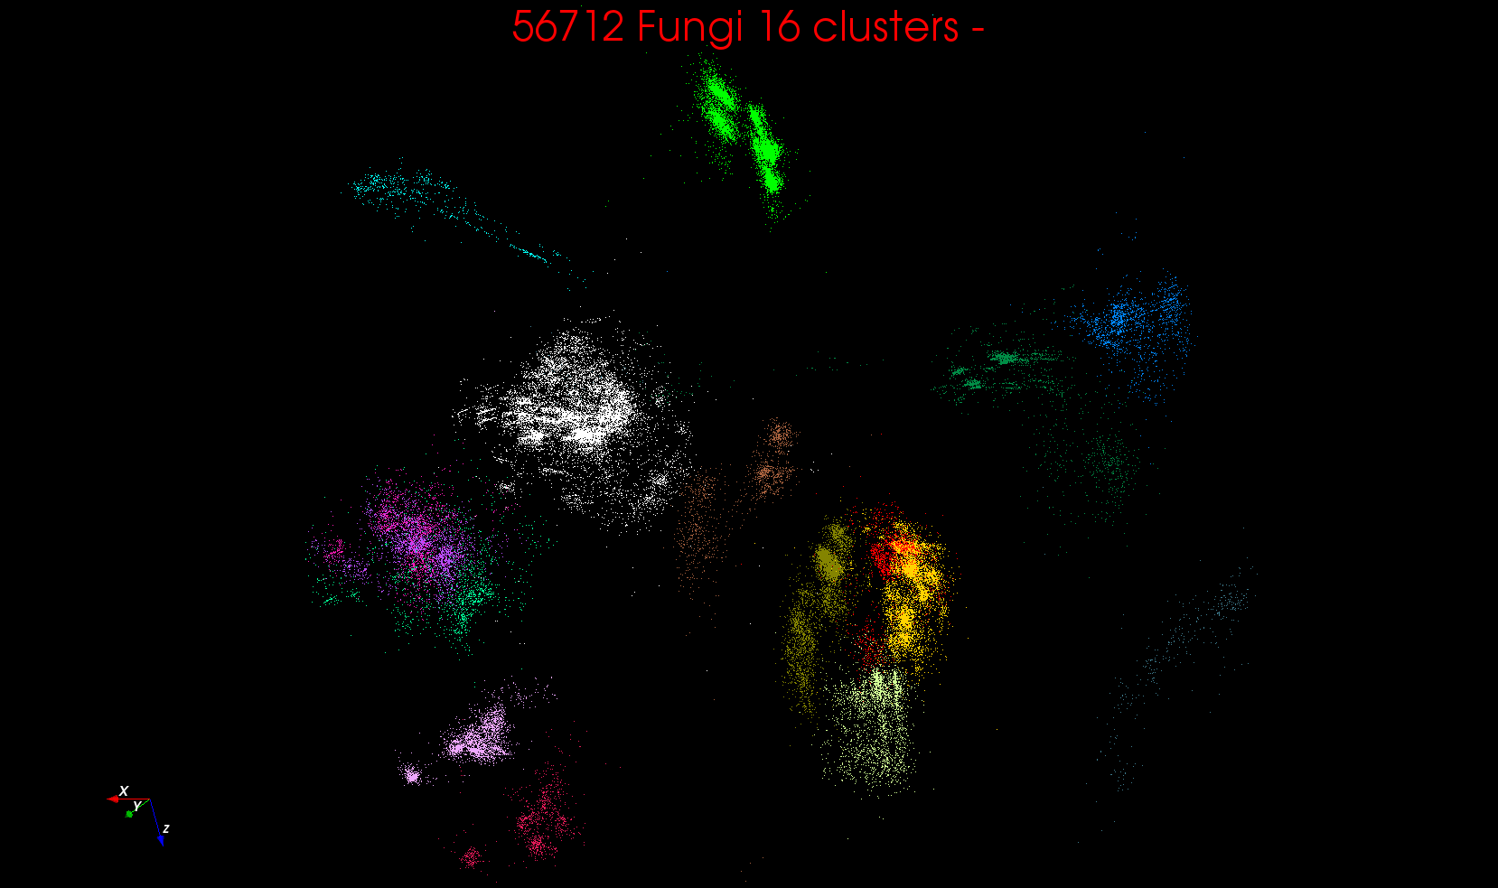

Slide 22
Applications

Slide 23
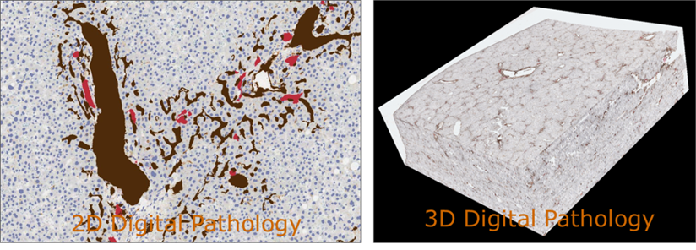
17:Pathology Imaging/ Digital Pathology I
Healthcare
Life Sciences
Application: Digital pathology imaging is an emerging field where examination of high resolution images of tissue specimens enables novel and more effective ways for disease diagnosis. Pathology image analysis segments massive (millions per image) spatial objects such as nuclei and blood vessels, represented with their boundaries, along with many extracted image features from these objects. The derived information is used for many complex queries and analytics to support biomedical research and clinical diagnosis.
MR, MRIter, PP, Classification
Streaming
Parallelism over Images

Slide 24
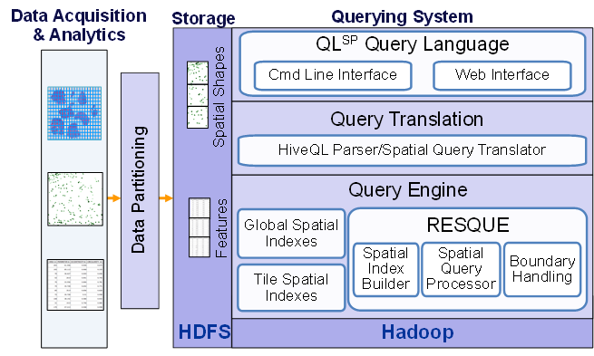
17:Pathology Imaging/ Digital Pathology II
Healthcare
Life Sciences
Current Approach: 1GB raw image data + 1.5GB analytical results per 2D image. MPI for image analysis; MapReduce + Hive with spatial extension on supercomputers and clouds. GPU’s used effectively. Figure below shows the architecture of Hadoop-GIS, a spatial data warehousing system over MapReduce to support spatial analytics for analytical pathology imaging.
Futures: Recently, 3D pathology imaging is made possible through 3D laser technologies or serially sectioning hundreds of tissue sections onto slides and scanning them into digital images. Segmenting 3D microanatomic objects from registered serial images could produce tens of millions of 3D objects from a single image. This provides a deep “map” of human tissues for next generation diagnosis. 1TB raw image data + 1TB analytical results per 3D image and 1PB data per moderated hospital per year.
Architecture of Hadoop-GIS, a spatial data warehousing system over MapReduce to support spatial analytics for analytical pathology imaging

Slide 25
26: Large-scale Deep Learning
Application: Large models (e.g., neural networks with more neurons and connections) combined with large datasets are increasingly the top performers in benchmark tasks for vision, speech, and Natural Language Processing. One needs to train a deep neural network from a large (>>1TB) corpus of data (typically imagery, video, audio, or text). Such training procedures often require customization of the neural network architecture, learning criteria, and dataset pre-processing. In addition to the computational expense demanded by the learning algorithms, the need for rapid prototyping and ease of development is extremely high.
Current Approach: The largest applications so far are to image recognition and scientific studies of unsupervised learning with 10 million images and up to 11 billion parameters on a 64 GPU HPC Infiniband cluster. Both supervised (using existing classified images) and unsupervised applications
Futures: Large datasets of 100TB or more may be necessary in order to exploit the representational power of the larger models. Training a self-driving car could take 100 million images at megapixel resolution. Deep Learning shares many characteristics with the broader field of machine learning. The paramount requirements are high computational throughput for mostly dense linear algebra operations, and extremely high productivity for researcher exploration. One needs integration of high performance libraries with high level (python) prototyping environments
Classified OUT
IN
Deep Learning, Social Networking GML, EGO, MRIter, Classify

Slide 26
27: Organizing large-scale, unstructured collections of consumer photos I
Deep Learning
Social Networking
Application: Produce 3D reconstructions of scenes using collections of millions to billions of consumer images, where neither the scene structure nor the camera positions are known a priori. Use resulting 3d models to allow efficient browsing of large-scale photo collections by geographic position. Geolocate new images by matching to 3d models. Perform object recognition on each image. 3d reconstruction posed as a robust non-linear least squares optimization problem where observed relations between images are constraints and unknowns are 6-d camera pose of each image and 3-d position of each point in the scene.
Current Approach: Hadoop cluster with 480 cores processing data of initial applications. Note over 500 billion images on Facebook and over 5 billion on Flickr with over 500 million images added to social media sites each day.
EGO, GIS, MR, Classification
Parallelism over Photos

Slide 27
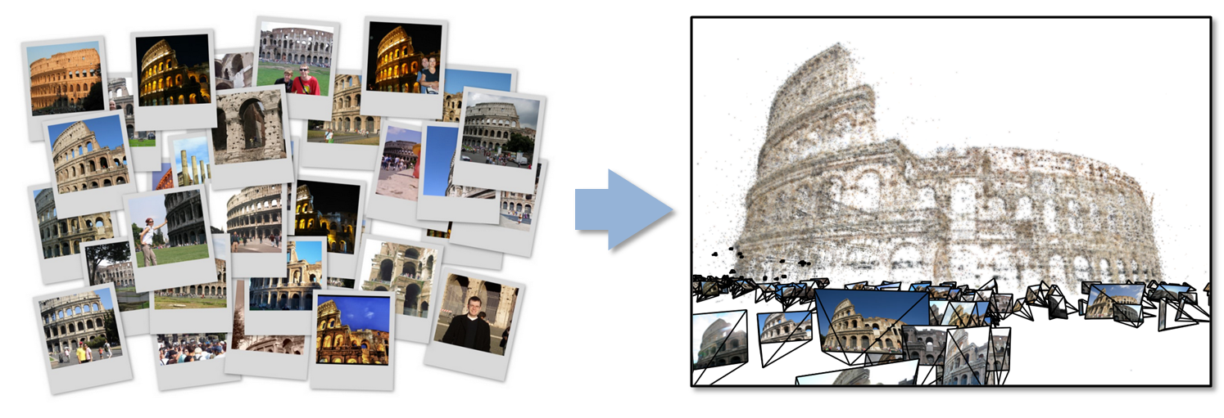
27: Organizing large-scale, unstructured collections of consumer photos II
Deep Learning
Social Networking
Futures: Need many analytics including feature extraction, feature matching, and large-scale probabilistic inference, which appear in many or most computer vision and image processing problems, including recognition, stereo resolution, and image denoising. Need to visualize large-scale 3-d reconstructions, and navigate large-scale collections of images that have been aligned to maps.

Slide 28
43: Radar Data Analysis for CReSIS Remote Sensing of Ice Sheets I
Application: This data feeds into intergovernmental Panel on Climate Change (IPCC) and uses custom radars to measures ice sheet bed depths and (annual) snow layers at the North and South poles and mountainous regions.
Current Approach: The initial analysis is currently Matlab signal processing that produces a set of radar images. These cannot be transported from field over Internet and are typically copied to removable few TB disks in the field and flown “home” for detailed analysis. Image understanding tools with some human oversight find the image features (layers) shown later, that are stored in a database front-ended by a Geographical Information System. The ice sheet bed depths are used in simulations of glacier flow. The data is taken in “field trips” that each currently gather 50-100 TB of data over a few week period.
Futures: An order of magnitude more data (petabyte per mission) is projected with improved instrumentation. Demands of processing increasing field data in an environment with more data but still constrained power budget, suggests low power/performance architectures such as GPU systems.
Earth, Environmental and Polar Science
PP, GIS
Streaming
Parallelism over Radar Images

Slide 29
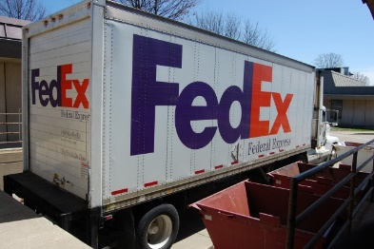
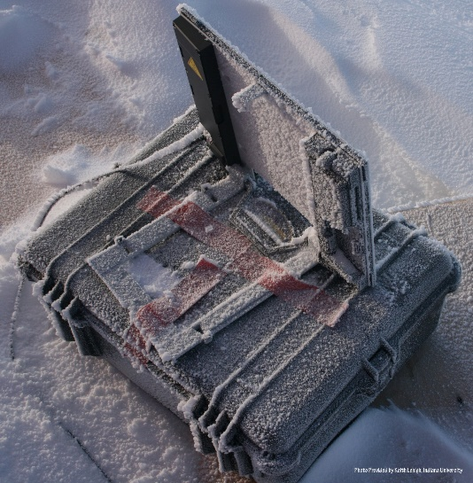
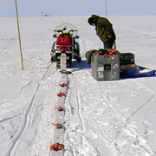
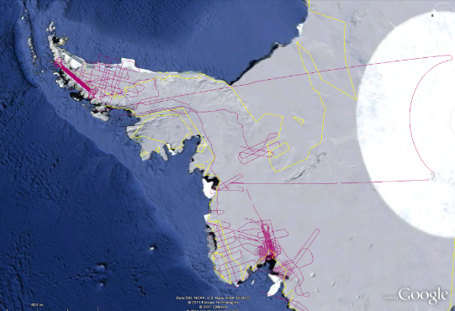
CReSIS Remote Sensing: Radar Surveys
Expeditions last 1-2 months and gather up to 100 TB data. Most is saved on removable disks and flown back to continental US at end. A sample is analyzed in field to check instrument

Slide 30
43: Radar Data Analysis for CReSIS Remote Sensing of Ice Sheets IV
Earth, Environmental and Polar Science
Typical CReSIS echogram with Detected Boundaries. The upper (green) boundary is between air and ice layer while the lower (red) boundary is between ice and terrain
PP, GIS
Streaming
Parallelism over Radar Images

